Slide 1

UNIT II
COMMUNICATION IN DISTRIBUTED SYSTEMS FOR DISTRIBUTED COMPUTING
Primitives for Distributed Communication.
Introduction to middleware. Message Oriented Communication, TCP and UDP characteristics and differences, Multicast Communication. Remote Methods Invocation[RMI] , Remote Procedure Call [RPC]

Slide 2
Primitives for distributed communication
Message send and message receive communication primitives are denoted Send() and Receive(), respectively.
A Send primitive has at least two parameters
– The destination, and the buffer in the user space, containing the data to be sent.
A Receive primitive has at least two parameters – The source from which the data is to be received (this could be a wildcard), and the user buffer into which the data is to be received.

Slide 3
There are two ways of sending data when the Send primitive is invoked – the buffered option and the unbuffered option.
The buffered option which is the standard option copies the data from the user buffer to the kernel buffer. The data later gets copied from the kernel buffer onto the network.
In the unbuffered option, the data gets copied directly from the user buffer onto the network.
For the Receive primitive, the buffered option is usually required because the data may already have arrived when the primitive is invoked, and needs a storage place in the kernel.

Slide 4
The following are some definitions of blocking/non-blocking and synchronous/ asynchronous primitives
Synchronous primitives A Send or a Receive primitive is synchronous if both the Send() and Receive() handshake with each other.
The processing for the Send primitive completes only after the invoking processor learns that the other corresponding Receive primitive has also been invoked and that the receive operation has been completed.
The processing for the Receive primitive completes when the data to be received is copied into the receiver’s user buffer.

Slide 5
Asynchronous primitives A Send primitive is said to be asynchronous if control returns back to the invoking process after the data item to be sent has been copied out of the user-specified buffer.
It does not make sense to define asynchronous Receive primitives.
Blocking primitives A primitive is blocking if control returns to the invoking process after the processing for the primitive (whether in synchronous or asynchronous mode) completes.

Slide 6
Blocking primitives
• The primitive commands wait for the message to be delivered. The execution of the processes is blocked.
• The sending process must wait after a send until an acknowledgement is made by the receiver.
• The receiving process must wait for the expected message from the sending process
• The receipt is determined by polling common buffer or interrupt.
• This is a form of synchronization or synchronous communication.
• A primitive is blocking if control returns to the invoking process after the processing for the primitive completes.

Slide 7
Non-blocking primitives A primitive is non-blocking if control returns back to the invoking process immediately after invocation, even though the operation has not completed.
For a non-blocking Send, control returns to the process even before the data is copied out of the user buffer.
For a non-blocking Receive, control returns to the process even before the data may have arrived from the sender.
For non-blocking primitives, a return parameter on the primitive call returns a system-generated handle which can be later used to check the status of completion of the call.

Slide 8
First, it can keep checking (in a loop or periodically) if the handle has been flagged or posted.
Second, it can issue a Wait with a list of handles as parameters.
The Wait call usually blocks until one of the parameter handles is posted.

Slide 9
Non Blocking primitives
• If send is nonblocking, it returns control to the caller immediately, before the message is sent.
For a non-blocking Send, control returns to the process even before the data is copied out of the user buffer
• The advantage of this scheme is that the sending process can continue computing in parallel with the message transmission, instead of having the CPU go idle.
• This is a form of asynchronous communication.
For a non-blocking Receive, control returns to the process even before the data may have arrived from the sender.

Slide 10
Inter- Process Communication
Characteristics of protocols for communication between processes in a distributed system – that is, interprocess communication
Interprocess communication in the Internet provides both datagram and stream Communication.
The interprocess communication primitives discussed above all support point-topoint communication, yet it is equally useful to be able to send a message from one sender to a group of receivers.
The Message Passing Interface (MPI) is a standard developed to provide an API for a set of message-passing operations with synchronous and asynchronous variants.

Slide 11
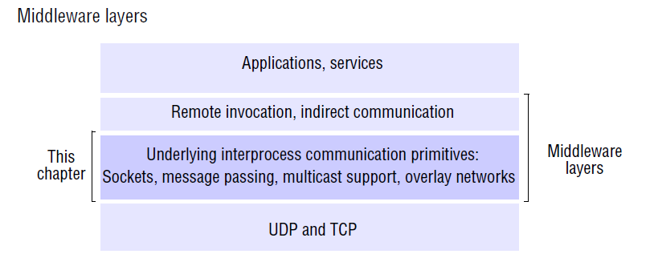

Slide 12
The API for the Internet protocols
Characteristics of inter-process communication
Message passing between a pair of processes can be supported by two message communication operations, send and receive, defined in terms of destinations and messages.
To communicate, one process sends a message (a sequence of bytes) to a destination and another process at the destination receives the message.
This activity involves the communication of data from the sending process to the receiving process and may involve the synchronization of the two processes.

Slide 13
Synchronous and asynchronous communication
A queue is associated with each message destination. Sending processes cause messages to be added to remote queues and receiving processes remove messages from local queues.
Communication between the sending and receiving processes may be either synchronous or asynchronous.
In the synchronous form of communication, the sending and receiving processes synchronize at every message.
In this case, both send and receive are blocking operations. Whenever a send is issued the sending process (or thread) is blocked until the corresponding receive is issued. Whenever a receive is issued by a process (or thread), it blocks until a message arrives.

Slide 14
In the asynchronous form of communication, the use of the send operation is nonblocking in that the sending process is allowed to proceed as soon as the message has been copied to a local buffer, and the transmission of the message proceeds in parallel with the sending process.
The receive operation can have blocking and non-blocking
variants.
In the non-blocking variant, the receiving process proceeds with its program after issuing a receive operation, which provides a buffer to be filled in the background, but it must separately receive notification that its buffer has been filled, by polling or interrupt.

Slide 15
Message destinations
In the Internet protocols, messages are sent to (Internet address, local port) pairs.
A local port is a message destination within a computer, specified as an integer.
A port has exactly one receiver ,but can have many senders.
Processes may use multiple ports to receive messages. Any process that knows the number of a port can send a message to it. Servers generally publicize their port numbers for use by clients.

Slide 16
Reliability
Reliable communication in terms of validity and integrity.
As far as the validity property is concerned, a point-to-point message service can be described as reliable if messages are guaranteed to be delivered despite a ‘reasonable’ number of packets being dropped or lost.
In contrast, a point-to-point message service can be described as unreliable if messages are not guaranteed to be delivered in the face of even a single packet dropped or lost.
For integrity, messages must arrive uncorrupted and without duplication.

Slide 17
Ordering
Some applications require that messages be delivered in sender order – that is, the order in which they were transmitted by the sender.
The delivery of messages out of sender order is regarded as a failure by such applications

Slide 18
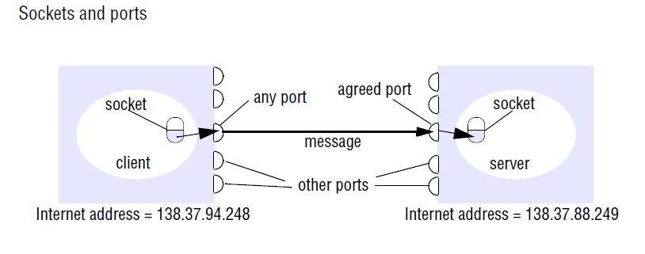
Sockets
Both forms of communication (UDP and TCP) use the socket abstraction, which provides an endpoint for communication between processes.

Slide 19
Interprocess communication consists of transmitting a message between a socket in one process and a socket in another process.
For a process to receive messages, its socket must be bound to a local port and one of the Internet addresses of the computer on which it runs.
Messages sent to a particular Internet address and port number can be received only by a process whose socket is associated with that Internet address and port number.
Java API for Internet addresses • As the IP packets underlying UDP and TCP are sent to Internet addresses, Java provides a class, InetAddress, that represents Internet addresses.

Slide 20
UDP datagram communication
A datagram sent by UDP is transmitted from a sending process to a receiving process without acknowledgement or retries.
A datagram is transmitted between processes when one process sends it and another receives it.
To send or receive messages a process must first create a socket bound to an Internet address of the local host and a local port.
A server will bind its socket to a server port – one that it makes known to clients so that they can send messages to it.
The receive method returns the Internet address and port of the sender, in addition to the message, allowing the recipient to send a reply.

Slide 21
The following are some issues relating to datagram communication:
Message size: The receiving process needs to specify an array of bytes of a particular size in which to receive a message. Any application requiring messages larger than the maximum must fragment them into chunks of that size.
Blocking: Sockets normally provide non-blocking sends and blocking receives for datagram communication (a non-blocking receive is an option in some implementations). The method receive blocks until a datagram is received, unless a timeout has been set on the socket.
Timeouts: Choosing an appropriate timeout interval is difficult, but it should be fairly large in comparison with the time required to transmit a message.

Slide 22
Receive from any: The receive method does not specify an origin for messages. Instead, an invocation of receive gets a message addressed to its socket from any origin.
Failure model for UDP datagrams
UDP datagrams suffer from the following failures:
Omission failures: Messages may be dropped occasionally, either because of a checksum error or because no buffer space is available at the source or destination. To simplify the discussion, we regard send-omission and receive-omission failures as omission failures in the communication channel.
Ordering: Messages can sometimes be delivered out of sender order.

Slide 23
Use of UDP • For some applications, it is acceptable to use a service that is liable to occasional omission failures. For example, the Domain Name System, which looks up DNS names in the Internet, is implemented over UDP.
Voice over IP (VOIP) also runs over UDP. UDP datagrams are sometimes an attractive choice because they do not suffer from the overheads associated with guaranteed message delivery.
There are three main sources of overhead:
• the need to store state information at the source and destination;
• the transmission of extra messages;
• latency for the sender.

Slide 24
TCP stream communication
Message sizes: The application can choose how much data it writes to a stream or reads from it. It may deal in very small or very large sets of data.
The underlying implementation of a TCP stream decides how much data to collect before transmitting it as one or more IP packets. On arrival, the data is handed to the application as requested.
Applications can, if necessary, force data to be sent immediately.

Slide 25
Lost messages: The TCP protocol uses an acknowledgement scheme.
As an example of a simple scheme (which is not used in TCP), the sending end keeps a record of each IP packet sent and the receiving end acknowledges all the arrivals. If the sender does not receive an acknowledgement within a timeout, it retransmits the message.
Flow control: The TCP protocol attempts to match the speeds of the processes that read from and write to a stream. If the writer is too fast for the reader, then it is blocked until the reader has consumed sufficient data.
Message duplication and ordering: Message identifiers are associated with each IP packet, which enables the recipient to detect and reject duplicates, or to reorder messages that do not arrive in sender order.

Slide 26
Message destinations: A pair of communicating processes establish a connection before they can communicate over a stream. Once a connection is established, the processes simply read from and write to the stream without needing to use Internet addresses and ports.
Establishing a connection involves a connect request from client to server followed by an accept request from server to client before any communication can take place. This could be a considerable overhead for a single client-server request and reply.

Slide 27
The following are some outstanding issues related to stream communication:
Matching of data items: Two communicating processes need to agree as to the contents of the data transmitted over a stream. For example, if one process writes an int followed by a double to a stream, then the reader at the other end must read an int followed by a double.
Blocking: The data written to a stream is kept in a queue at the destination socket. When a process attempts to read data from an input channel, it will get data from the queue or it will block until data becomes available.
Threads: When a server accepts a connection, it generally creates a new thread in which to communicate with the new client. The advantage of using a separate thread for each client is that the server can block when waiting for input without delaying other clients.

Slide 28
Failure model • To satisfy the integrity property of reliable communication, TCP streams use checksums to detect and reject corrupt packets and sequence numbers to detect and reject duplicate packets.
For the sake of the validity property, TCP streams use timeouts and retransmissions to deal with lost packets. Therefore, messages are guaranteed to be delivered even when some of the underlying packets are lost.
Use of TCP • Many frequently used services run over TCP connections, with reserved port numbers. These include the following:
HTTP:.
FTP:
Telnet:
SMTP

Slide 29
External data representation and marshalling
Irrespective of the form of communication used, the data structures must be flattened (converted to a sequence of bytes) before transmission and rebuilt on arrival.
Not all computers store primitive values such as integers in the same order.
The representation of floating-point numbers also differs between architectures. There are two variants for the ordering of integers: the so-called big-endian order, in which the most significant byte comes first; and little-endian order, in which it comes last.
.

Slide 30
Another issue is the set of codes used to represent characters:
for example, the majority of applications on systems such as UNIX use ASCII character coding, taking one byte per character, whereas
The Unicode standard allows for the representation of texts in many different languages and takes two bytes per character

Slide 31
One of the following methods can be used to enable any two computers to exchange binary data values:
• The values are converted to an agreed external format before transmission and converted to the local form on receipt; if the two computers are known to be the same type, the conversion to external format can be omitted.
• The values are transmitted in the sender’s format, together with an indication of the format used, and the recipient converts the values if necessary.
An agreed standard for the representation of data structures and primitive values is called an external data representation.

Slide 32
Marshalling is the process of taking a collection of data items and assembling them into a form suitable for transmission in a message.
Unmarshalling is the process of disassembling them on arrival to produce an equivalent collection of data items at the destination.
Marshalling consists of the translation of structured data items and primitive values into an external data representation. Similarly,
Unmarshalling consists of the generation of primitive values from their external data representation and the rebuilding of the data structures.

Slide 33
Three alternative approaches to external data representation
CORBA’s common data representation, which is concerned with an external representation for the structured and primitive types that can be passed as the arguments and results of remote method invocations in CORBA. It can be used by a variety of programming languages.
Java’s object serialization, which is concerned with the flattening and external data representation of any single object or tree of objects that may need to be transmitted in a message or stored on a disk. It is for use only by Java.

Slide 34
XML (Extensible Markup Language), which defines a textual fomat for representing structured data.
It was originally intended for documents containing textual self-describing structured data – for example documents accessible on the Web – but it is now also used to represent the data sent in messages exchanged by clients and servers in web services.

Slide 35
Multicast communication
The pairwise exchange of messages is not the best model for communication from one process to a group of other processes.
A multicast operation is more appropriate – this is an operation that sends a single message from one process to each of the members of a group of processes, usually in such a way that the membership of the group is transparent to the sender.
Multicast messages provide a useful infrastructure for constructing distributed systems with the following characteristics:

Slide 36
Fault tolerance based on replicated services: A replicated service consists of a group of servers. Client requests are multicast to all the members of the group, each of which performs an identical operation. Even when some of the members fail, clients can still be served.
Discovering services in spontaneous networking: Multicast messages can be used by servers and clients to locate available discovery services in order to register their interfaces or to look up the interfaces of other services in the distributed system.
3. Better performance through replicated data: Data are replicated to increase the performance of a service – in some cases replicas of the data are placed in users’ computers. Each time the data changes, the new value is multicast to the processes managing the replicas.

Slide 37
4. Propagation of event notifications: Multicast to a group may be used to notify processes when something happens. For example, in Facebook, when someone changes their status, all their friends receive notifications. Similarly, publish subscribe protocols may make use of group multicast to disseminate events to subscribers.
IP multicast
IP multicast allows the sender to transmit a single IP packet to a set of computers that form a multicast group. The sender is unaware of the identities of the individual recipients and of the size of the group.
A multicast group is specified by a Class D Internet address.

Slide 38
Being a member of a multicast group allows a computer to receive IP packets sent to the group.
The membership of multicast groups is dynamic, allowing computers to join or leave at any time and to join an arbitrary number of groups.
Multicast routers: IP packets can be multicast both on a local network and on the wider Internet. Local multicasts use the multicast capability of the local network, for example, of an Ethernet. Internet multicasts make use of multicast routers, which forward single datagrams to routers on other networks, where they are again multicast to local members.

Slide 39
Multicast address allocation: Class D addresses (that is,
addresses in the range 224.0.0.0 to 239.255.255.255) are reserved for multicast traffic and managed globally by the Internet Assigned Numbers Authority (IANA).
• Local Network Control Block (224.0.0.0 to 224.0.0.225), for multicast traffic within a given local network.
• Internet Control Block (224.0.1.0 to 224.0.1.225).
• Ad Hoc Control Block (224.0.2.0 to 224.0.255.0), for traffic that does not fit any other block.
• Administratively Scoped Block (239.0.0.0 to 239.255.255.255), which is used to implement a scoping mechanism for multicast traffic (to constrain propagation).

Slide 40
REMOTE INVOCATION
How processes (or entities at a higher level of abstraction such as objects or services) communicate in a distributed system
Request-reply protocols represent a pattern on top of message passing and support the two-way exchange of messages as encountered in client-server computing. In particular, such protocols provide relatively low-level support for requesting the execution of a remote operation, and also provide direct support for RPC and RMI.

Slide 41
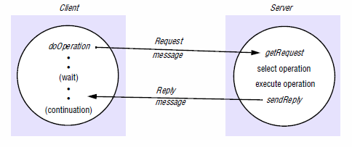
This form of communication is designed to support the roles and message exchanges in typical client-server interactions. In the normal case, request-reply communication is synchronous because the client process blocks until the reply arrives from the server.

Slide 42
REMOTE PROCEDURE CALLS

Slide 43
AGENDA
Introduction to RPC
Conventional Procedure Call
Semantics of RPC
Client and Server Stubs
Steps of a Remote Procedure Call
Passing Value Parameters
Parameter Specification
Stub Generation
Server Management
Dynamic Binding
RPC Semantics in Presence of Failures
Implementation Issues
Problem Areas

Slide 44
INTRODUCTION TO RPC(1)
The communication is built upon input/output.
The procedures send & receive are fundamentally engaged in doing I/O.
Birrell & Nelson introduced the concept of RPC.
When process A on machine calls a procedure on machine B, the calling process on A is suspended, and execution of the called procedure takes place on B.

Slide 45
INTRODUCTION TO RPC (2)
Information can be transported from the caller to callee in the parameters & can come back in procedure result.
No message passing or I/O at all is visible to the programmer.

Slide 46
CONVENTIONAL PROCEDURE CALL (1)
How does a conventional (i.e. single machine) procedure call work?
Consider a call
count = read (fd, buf, bytes);
where fd is an integer, buf is array of characters, and
nbytes is another integer.

Slide 47
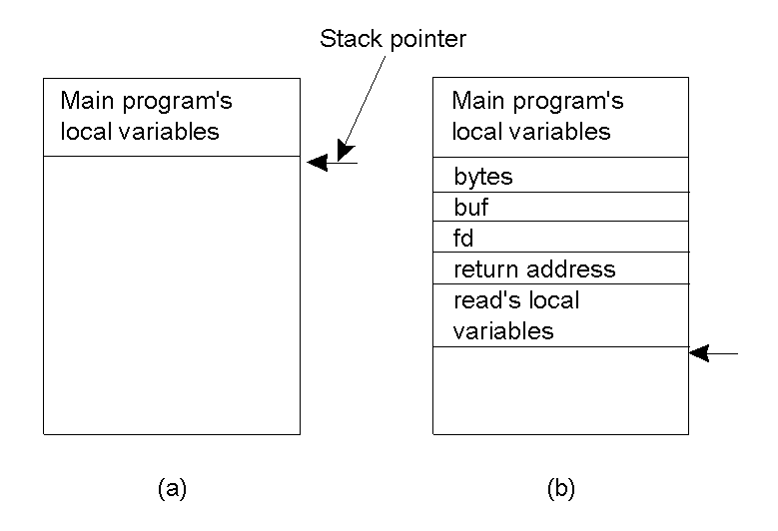
CONVENTIONAL PROCEDURE CALL (2)
Parameter passing in a local procedure call: the stack before the call to read
The stack while the called procedure is active

Slide 48
CONVENTIONAL PROCEDURE CALL (3)
  For a function call to execute , the caller pushes the a parameters onto stack in order, last in first, as was shown in the figure.
  After read’s execution, it puts return value in a register, removes the return address from stack , and transfers control back to the caller.
  The caller removes the parameters from the stack, returning it to the original state.
Parameter passing ways
  Call-by-reference
  Call-by-value
Depends on language or programmer’s need.

Slide 49
SEMANTICS OF RPC (1)
  The idea behind RPC is to make remote procedure call look as much as possible like a local one.
  RPC must be transparent.
  The calling procedure should not be aware that the called procedure is executing on the remote machine, or vice versa.

Slide 50
SEMANTICS OF RPC (2)
  The programmer puts a call to read in the code to get the data.
  The read routine is extracted from the library by the linker & inserted into the object program.
  It is a procedure, written in assembly language, that puts the parameters in the registers and then issues READ system call by trapping to the kernel.
  The read procedure is an interface between the user code and the operating system.

Slide 51
SEMANTICS OF RPC (3)
RPC achieves its transparency in the following way.
When read is remote procedure, a different version of read, called a client stub, is put into the library.
It packs the a parameters into a message and asks the kernel to send the message to the server.

Slide 52
SEMANTICS OF RPC (4)
When the message arrives at the server, the kernel passes it up to server stub that is bound to the actual server.
The server stub gets blocked waiting for incoming messages by calling receive.
The server stub unpacks the parameters from message and then calls server procedure in usual way.
The server executes the procedure in usual way as if it is its own procedure using the parameters it has received from server stub.

Slide 53
SEMANTICS OF RPC (5)
It returns the result to server sub.
Server stub packs the result in a message and calls send (by trapping into the kernel) to return it to the client.
When the message gets back to the client machine, the kernel sends to the client stub.
Client stub inspects the message, unpacks the result & copies it to the caller & returns in the usual way.
The client remains in the blocking state until the procedure gets completed on server.

Slide 54
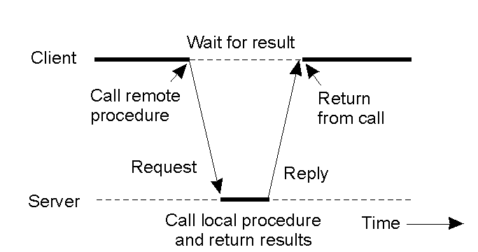
CLIENT AND SERVER STUBS
Principle of RPC between a client and server program.

Slide 55
STEPS OF A REMOTE PROCEDURE CALL
Client procedure calls client stub in normal way
Client stub builds message, calls local OS
Client's OS sends message to remote OS
Remote OS gives message to server stub
Server stub unpacks parameters, calls server
Server does work, returns result to the stub
Server stub packs it in message, calls local OS
Server's OS sends message to client's OS
Client's OS gives message to client stub
Stub unpacks result, returns to client

Slide 56
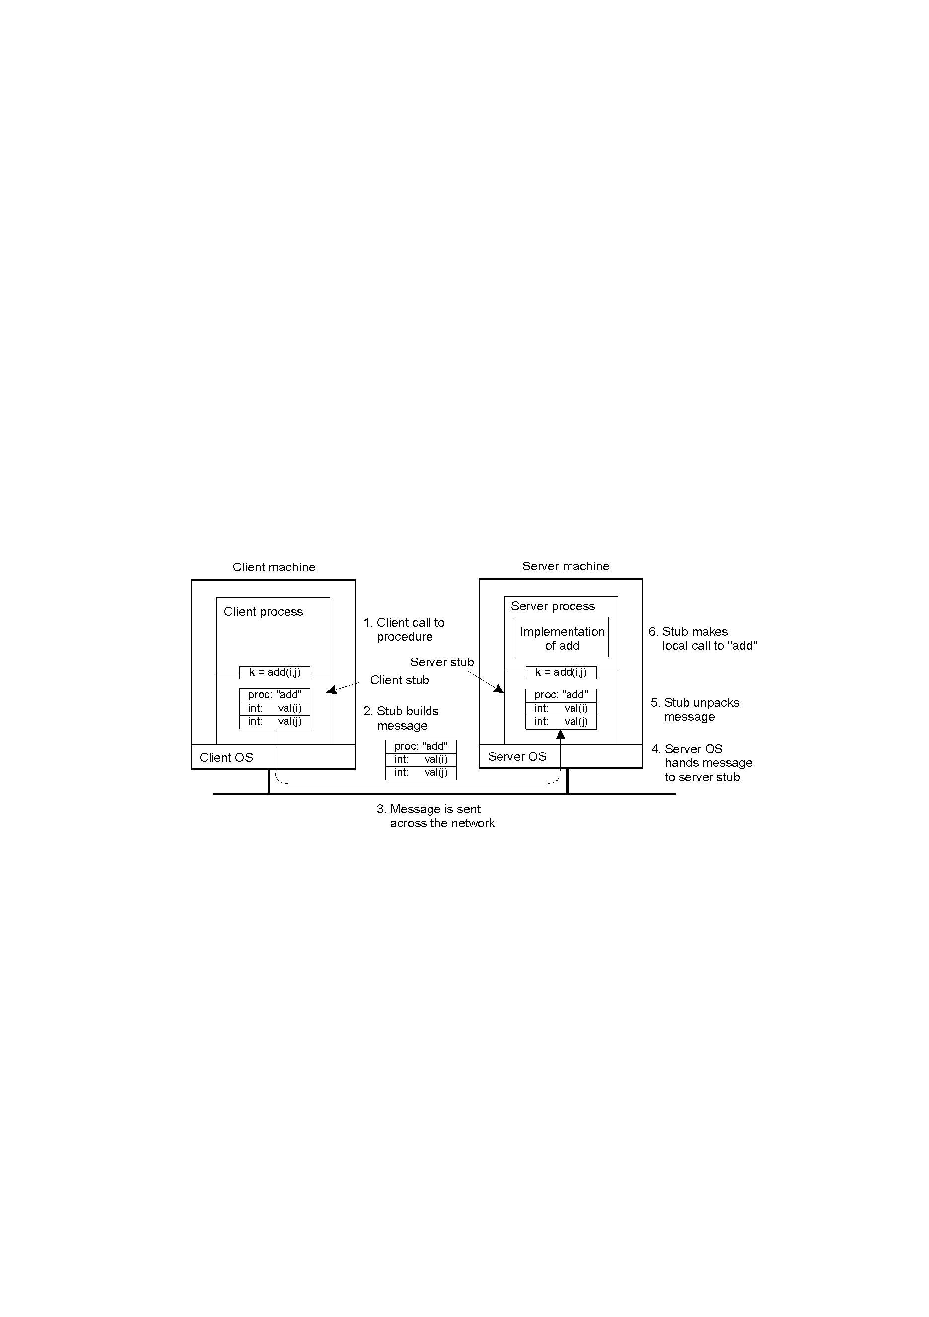
PASSING VALUE PARAMETERS (1)
Steps involved in doing remote computation through RPC

Slide 57
PASSING VALUE PARAMETERS (2)
Packing parameters into a message is called as parameter marshalling.
Consider a remote procedure add(i,j)
The client stub takes its two parameters and builds them in a message.
It puts the name or number of the procedure to be called in the message.

Slide 58
PASSING VALUE PARAMETERS (3)
When the message arrives at the server, the stub examines the message and makes appropriate call.
When server executes the procedure, server stub takes control.
It takes result, packs it into a message & sent back to the client.

Slide 59
PASSING VALUE PARAMETERS (4)
The above model runs for when server & client machines are identical.
Ex. IBM mainframes use EBCDIC character code, whereas IBM PCs use ASCII.
It is not possible to pass a character parameter from an IBM PC client to an IBM mainframe server using the above scheme.

Slide 60
PASSING VALUE PARAMETERS (5)
Representation of integers may be different in different architectures (1’s complement versus 2’s complement).
Another problem is byte ordering.
Intel number their bytes from right to left, this format is called as little endian.
SPARC number their bytes from left to right, this format is called as big endian.

Slide 61

PASSING VALUE PARAMETERS (6)
Original message on the Pentium
The message after receipt on the SPARC
The message after being inverted.
The little numbers in boxes indicate the address of each byte

Slide 62
PARAMETER SPECIFICATION (1)
The information about the parameters specification & procedure is available with clients & servers.
The message contains n+1 fields with n the no of parameters & 1 field for procedure specification.
Representation of basic types must be agreed upon by both parties, it is possible to deduce the byte ordering from it.
Ex. Consider the procedure given in the following figure.

Slide 63

PARAMETER SPECIFICATION (2)
A procedure
The corresponding message.

Slide 64
PARAMETER SPECIFICATION (3)
Decide on all other issues
Integer representation ( 1’s or 2’s complement)
Character representation (EBCDIC or ASCII)
Use of byte ordering i.e. little endian or big endian so different m/c s need to convert the representation in one of the forms.

Slide 65
DEALING WITH POINTERS (1)
Consider the read example discussed earlier.
It has second parameter an address of the buffer which happens to be say 0x 8586AFCF on the client.
This address can not be sent to the destination as address space would be different on second machine.
Copy the contents pointed by pointer into the message & send it to the server.

Slide 66
DEALING WITH POINTERS (2)
If the stubs know whether the buffer is in input parameter or an output parameter to the server, one of the copies can be eliminated.
If the array is input to the server, then it need not be copied back & if it is output, it need not to be sent to the server.
Simple arrays & structures can be passed
Complex graph & tree can not be sent

Slide 67
STUB GENERATION (1)
Two methods: -
1. Manual stub generation
RPC implementer provides a set of translation functions from which a user can construct his or her own stubs.
2. Automatic stub generation
Given a specification of server procedure & the encoding rules, the message format is generated uniquely.
Compiler will read server specification & generate a client stub that packs its parameters into approved message format.
Similarly server stub can be generated.

Slide 68
STUB GENERATION (2)
Automatic stub generation uses Interface Definition Language (IDL) that is used to define the interface between a client & a server.
An interface definition is mainly list of procedure names supported by the interface, together with the types of their arguments & results.
This is sufficient info for client & server to independently perform compile-time type checking & to generate appropriate calling sequences.
An interface definition also has information that helps RPC reduce data storage and the amount of the data to be transferred over the network.

Slide 69
STUB GENERATION (3)
For ex. An interface definition has info to indicate whether each argument is input, output, or both.
An interface definition has info about the type definitions, enumerated types, and defined constants that each side uses to manipulate data from RPC calls.
A server program that implements the procedures in an interface is said to export the interface.
A client program that calls the procedures from an interface is said to import the interface.

Slide 70
STUB GENERATION (4)
Firstly interface definition (ID)is developed.
The ID is processed using an IDL compiler to generate components that can be combined with the client & server programs, without making any changes to the existing compilers.
From ID, IDL compiler generates
1. A client stub procedure for each procedure in the
interface.
2. A server stub procedure for each procedure in the
interface.
3.The appropriate marshalling and unmarshalling operations
in each stub procedure.
4. A header file that supports the data types in the I.D.

Slide 71
STUB GENERATION (5)
The header file is included in the source files of both
client & server programs.
The client stub procedures are compiled & linked with client program.
The server stub procedures are compiled & linked with server program
An IDL compiler can be designed to process interface definitions for use with different languages, enabling clients & servers can be written in different languages, to communicate by using RPC.

Slide 72
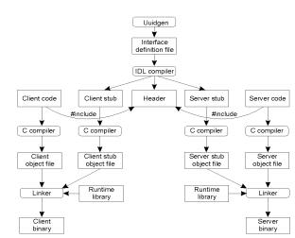
THE STEPS IN WRITING A CLIENT AND A SERVER IN DCE RPC
(SUN RPC IS SIMILAR)

Slide 73
SERVER MANAGEMENT(1)
- Issues in RPC-based applications for Server
Management
  Server Implementation
  Server Creation
- Server Implementation
  Stateful servers
  Stateless servers

Slide 74
SERVER MANAGEMENT (2)
- Stateful servers
  A stateful server maintains clients’ state information from one remote procedure to the next.
  .In case of two subsequent calls by a client to the stateful server, some state information pertaining to the service performed for the client as a result of the first call execution is maintained by the server process.
  These clients’ state information is subsequently used at the time of executing the second call.

Slide 75
SERVER MANAGEMENT (3)
- Following operations are performed by server for clients.
  Open(filename, mode);
  Read(fid,n,buffer);
  Write(fid, n, buffer);
  Seek (fid, position);
  Close(fid);

Slide 76
SERVER MANAGEMENT (4)
Stateless servers
  A stateless server does not maintain any client state information.
  Every request from a client must be accompanied with all necessary parameters to successfully carry out the desired operation.
  Following operations are performed by server for clients
    Read (filename, position, n, buffer);
    Write(filename, position, n, buffer);
  Client has to keep state information.

Slide 77
SERVER MANAGEMENT (5)
  Server Creation Semantics
    Server processes may either be created and installed before their client processes or be created on a demand basis.
    Based on time duration for which RPC severs survive, they may be classified as
      Instance-per-call servers
      Instance-per-session servers
      Persistent servers

Slide 78
SERVER MANAGEMENT (6)
Instance-per-call servers
  Servers belonging to this category exist only for the duration of a single call.
  A server of this type is created by RPCRuntime on the server machine only when a call message arrives.
  The server is deleted after the call has been executed.

Slide 79
SERVER MANAGEMENT (7)
Problems with Instance-per-call servers
  The servers of this type are stateless because they are killed as soon as they have serviced the call for which they were created.
  Either OS at server or client can maintain state information.
  Expensive approach as every time server needs to be created

Slide 80
SERVER MANAGEMENT (8)
Instance-per-session servers
  Servers in this approach are intact for compete session between a client & a server.
  Can maintain state information
  Overhead for creation & maintaining servers is minimized

Slide 81
SERVER MANAGEMENT (9)
- Implementation of Instance-per-session servers
  Server manager exists for each type of service.
  All server managers are registered with binding agent
  When a client requests for any service, the binding agent returns the client with address of server serving that request.
  Client contacts server manager for the service.

Slide 82
SERVER MANAGEMENT (10)
Implementation of Instance-per-session servers Contd..
  Server manager spawns a new server & passes back its address to the client
  Client interacts with server directly for the entire session
  This server is created only for that client who has requested the server to be created

Slide 83
SERVER MANAGEMENT (11)
- Persistent servers
  A persistent server exists indefinitely.
  Shared by any clients unusual the earlier approaches.
  Such servers independently export their service by registering themselves with the binding agent.

Slide 84
SERVER MANAGEMENT (12)
- Persistent Servers Contd..
  Same approach as with session servers.
  Management of several sets of state information as it would be
  handling no. of clients concurrently.
  Load balancing by having a single service given to many servers.

Slide 85
DYNAMIC BINDING (1)
  How client locates a server ?
  One method is just to hardwire the network address of the server into the client.
  Approach is extremely inflexible as server might change.
  To overcome the above approach dynamic binding is used.

Slide 86
DYNAMIC BINDING (2)
# include <header.h>
Specification of file_server, version 3.1:
  long read(in char name[MAX_PATH ], out char buf[BUF_SIZE], in long bytes, in long position);
  Long write(in char name[MAX_PATH ], out char buf[BUF_SIZE], in long bytes, in long position);
  int create ( in char[MAX_PATH], in char buf[BUF_SIZE], in long bytes, in long position);
  int delete(in char[MAX_PATH]);

Slide 87
DYNAMIC BINDING (3)
The binder interface
Call | Input | Output
Register | Name,version,handle , unique id
Deregister | Name,version, unique id
Lookup | Name,version | Handle, Unique id

Slide 88
DYNAMIC BINDING (4)
Implementation of dynamic binding for stateless server(1)
Server’s formal specification is given
Stub generator will take this as input & produces both client & server stubs
Both stubs will be put up in the respective libraries of client & server
A user (client) program calls any of the procedures defined by this specification, the corresponding stub procedure is linked into its binary
When the server is compiled, the server stub is linked to its binary

Slide 89
DYNAMIC BINDING (5)
Implementation of dynamic binding for stateless server(2)
When the server begins executing, server interface is exported.
Server sends a message to a program called as binder , to make its existence known.
This process is called as registering server.
To register with the binder, server gives the binder its name, its version number, a unique identifier , typically 32 bits long, and a handle used to locate it.
The handle is system dependent & might be Ethernet address, an IP address, an X.500 address ,etc…
A server also can deregister from binder if it does not offer a service.

Slide 90
DYNAMIC BINDING (6)
Implementation of dynamic binding for stateless server(3)
  When the client calls one of the remote procedures for the first time, say, read, the client stub sees that it is not yet bound to a server.
  Client sends a message to the binder asking to import version 3.1of the file_server interface.
  The binder checks to see if one or more servers have already exported an interface with this name & version number.
  If any server has not exposed the interface then read returns an error
  If server exists , the binder gives its handle and unique id to the client stub.

Slide 91
DYNAMIC BINDING (7)
Implementation of dynamic binding for stateless server(4)
  The client stub uses the handle as the address to send the request message to.
  The message contains the parameters & the unique id., which server’s kernel uses to redirect the message to the correct server in the event of several servers are running on that machine.
  This method corresponds to the persistent server approach.

Slide 92
DYNAMIC BINDING (8)
  Advantages of this approach
    Can handle multiple servers that support the same interface
    The binder can spread the clients randomly over the servers to even the load.
    It can also poll the servers periodically, automatically deregistering any server that fails to respond, to achieve the fault tolerance.
    Assistance in authentication.

Slide 93
DYNAMIC BINDING (8)
Disadvantages of this approach
  Extra overhead of importing & exporting the interfaces.
  Binder may be a bottleneck, may overrun, requires multiple binders
  Registration & deregistration of servers have to be done.
  All binders should be updated

Slide 94
RPC SEMANTICS IN PRESENCE OF FAILURES(1)
The client is unable to locate the server
The request message from the client to the server is lost.
The reply message from the server to the client is lost.
The server crashes after receiving a request
The client crashes after sending a request.

Slide 95
RPC SEMANTICS IN PRESENCE OF FAILURES(2)
The client is unable to locate the server
  Server might be down
  Client is compiled using a particular version of the client stub, and binary is not used for the considerable amount of time
  If server is installed with new version and new stubs are generated then binder will be unable to match it up with a server & will report a failure.

Slide 96
RPC SEMANTICS IN PRESENCE OF FAILURES(3)
The client is unable to locate the server contd….
  Errors should be reported to clients
  -1 for error, error no as in UNIX, 0 for success.
  Exceptions can be reported
  In some languages e.g . Ada programmers can write special procedures that are invoked upon specific errors.
  C language has signal handlers
  Not every language supports exceptions.

Slide 97
RPC SEMANTICS IN PRESENCE OF FAILURES(4)
2. Lost request messages
  Timer can be with client’s kernel
  Resending of the message again
  Kernel will stop sending the messages having sent number of retransmissitted messages
  Finally it concludes that server is down
  When server is down first case is considered.

Slide 98
RPC SEMANTICS IN PRESENCE OF FAILURES(5)
3. Lost reply messages
  The timer can be a solution.
  Client’s kernel is not sure why there was no answer.
  Request, reply or server could be a problem
  Dealing with idempotency & non-idempotency
  Sequence numbering must be done by client’s kernel

Slide 99
RPC SEMANTICS IN PRESENCE OF FAILURES (6)
Server crashes
  Normal case
  Crash after execution
  Crash before execution
  At least once semantics
-RPC is carried out at least once time, but possibly more
  At most semantics
-RPC is carried out at most once time, but possibly none at all
  Exactly once semantics
-RPC is carried out at exactly once time.

Slide 100
RPC SEMANTICS IN PRESENCE OF FAILURES (7)
5. Client crashes
  Client sends a request for computation & crashes
Four proposed solutions
  Extermination
  Reincarnation
  Gentle Reincarnation
  Expiration

Slide 101
RPC SEMANTICS IN PRESENCE OF FAILURES (8)
1. Extermination
  Before a client stub sends a RPC message, it makes a log entry telling what it is about to do.
  Log is kept on disk or on any other medium that survives crashes
  After reboot, log is checked & the orphan is explicitly killed off.
  Overhead of writing to the disk for every RPC record
2. Reincarnation
  Divide time up into sequentially numbered epochs
  When a client reboots, it broadcasts a message to all machines declaring start of new epoch
  When such epoch comes in, all remote computations are killed

Slide 102
RPC SEMANTICS IN PRESENCE OF FAILURES (9)
3. Gentle Reincarnation
  When such epoch comes in, each machine checks to see if it has remote computations, and if so, it tries to locate an owner
  The computation would be killed only if the owner cannot be found
4. Expiration
  Every RPC is given standard amount of time T, to do the job.
  If it cannot finish, it must explicitly ask for another time quantum.

Slide 103
IMPLEMENTATION ISSUES
RPC protocols
Acknowledgements
Critical path
Copying
Timer Management

Slide 104
RPC PROTOCOLS (1)
Choice of RPC protocol
  Connection-oriented protocol versus connection-less protocol
  Using connection-oriented protocol has advantage of handling reliability.
  It has disadvantage of having complexity in software.
  Use IP on top of TCP/UDP
  No need to have separate RPC protocol implemented
  Many existing networks systems use UDP/IP
  UNIX systems use UDP/IP

Slide 105
RPC PROTOCOLS (2)
- Performance problems using UDP/IP
No reliability
Total fields in IP packet header –13
Sender address, receiver address & packet length, remaining unnecessary.
One of the fields – checksum needs computation which is time consuming & on the top of IP –we have UDP which has another checksum

Slide 106
RPC PROTOCOLS (3)
-Are alternatives available ?
Use specialized RPC protocol
Needs to be invented, implemented, tested & embedded into existing systems.
No such a protocol exists as yet.

Slide 107
RPC PROTOCOLS (4)
Issue related to packet & message length
Reading 64K file in a single 64K RPC is vastly more efficient than reading it in 64 1K RPCs.
Ex. Sun Microsystem’s limit for RPC is 8K.
Many networks can not handle large packets.
Ex. Ethernet’s capacity is 1536 bytes, so single RPC will have to be split over multiple packets - extra overhead.

Slide 108
ACKNOWLEDGEMENTS
Splitting the RPC into small packets when RPC is large
Acknowledge every packet (stop & wait protocol)
Acknowledge only once (blast protocol)
Flow control
Overrun or overflow error

Slide 109
REMOTE METHOD INVOCATION (RMI)
Main Idea: Working with an object on a remote machine is made to look like calli ng a procedure on the remote site, i.e.
the application/client sends a message to the remote object
the remote object receives message, does processing and sends back message with results - the server side;
the client receives message and uses/prints result
Server Side
Client Side
send client data
(request)
Remote Object
runs procedure
receive server data/result
(reply)

Slide 110
More specifically RMI specification goals are listed as follows (http://java.sun.com/products/jdk/1.2/docs/guide/rmi/spec/rmi-title.doc.html)
Support seamless remote invocations on objects in different JVMs.
Support callbacks from servers to clients.
Integrate the distributed object model into the Java programming language in a natural way while retaining most of the language's object semantics.
Make writing distributed applications as simple as possible (certainly simpler than with sockets).
Preserve the safety provided by the Java run-time environment.
and extensibility are provided by:
Distributed garbage collection.
Capability to support multiple transports
Varying remote invocation mechanisms, such as unicast and multicast

Slide 111
DISTRIBUTED APPLICATION TASKS
Locate Remote Objects: Application can obtain references to remote objects when
a) objects are registered with the RMI naming facility, the rmiregistry,
or
b) application can pass and return remote object references as part of its normal operation
Communicate with remote objects: handled by RMI; looks like standard Java method invocation to the programmer
Load class bytecodes for objects that are passed as parameters or return values: Because RMI allows a caller to pass pure Java objects to remote object, RMI provides the necessary mechanisms for loading an object's code as well as transmitting its data

Slide 112
USING THE REGISTRY TO OBTAIN REFERENCES TO REMOTE OBJECT
Registry
RMI
RMI
Client
Server
RMI
URL
protocol
Web Server
URL
protocol
Web Server
Server calls registry to associate name with a remote object.
Client looks up remote object by name in server's registry.
Client invokes method on object
Note: The RMI system uses an existing web server to load Java class bytecodes, from server to client and from client to server, when needed. RMI can load class bytecodes using any URL protocol (e.g. HTTP, FTP, file, etc.) that is supported by the Java system.

Slide 113
RMI ARCHITECTURE
OSI Model
Client
Server
Application
Presentation
Stub
Skeleton
Remote Reference Layer
Session
Transport Layer
Transport
The layers are independent.
Each layer is defined by specific protocol and built using specific interface.
Any layer can be replaced by an alternate implementation without affecting the others, e.g. the current transport layer in RMI is TCP based, but can be substituted by a UDP based transport layer

Slide 114
RMI ARCHITECTURE (CONTINUED)
Stub/Skeleton Layer: Interface of the application with the rest of the system (standard mechanism used in RPC system). This layer transmits the data to the remote reference layer via the abstraction of marshal streams that use object serialization.
A stub is a surrogate for the remote object, its representative on the client side, that acts as a proxy for the remote object. It resides on the client side (although it is generated on the server side) and handles all the interaction with the remote object
A skeleton handles the communication on the server side (not required in JDK1.2-only environments)
Remote Reference Layer: responsible for providing ability to support varying remote reference or invocation protocols independent of client stubs and server skeletons.
Examples: unicast provides point-to-point invocation, multicast to groups of objects; other protocols deal with replication strategies or persistent references to the remote object, such as enabling remote object activation (supported only by Java2)

Slide 115
RMI ARCHITECTURE (CONTINUED)
Transport Layer: Low level layer that ships the marshal streams between different address spaces. Responsible for managing connection:
Setting up connections
Listening to incoming calls
Maintaining table of remote objects that reside in same address space
Remote object references are represented by an object identifier and end point. This representation is called a live reference. Given a live reference for a remote object the identifier looks up the targeted remote object and the end point sets up the connection to the address space the object resides

Slide 116
PARAMETER MARSHALLING AND UNMARSHALLING
When a client code invokes a remote method on a remote object, it actually calls an ordinary/local Java method encapsulated in the stub.
The stub encodes the parameters used in the remote method with a device-independent encoding and transforms them in a format suitable for transport. The process of encoding, writing to a stream and sending an object is referred as parameter marshalling.
Thus the stub method on the client side builds an information block that consists of:
Identifier of remote object to be used;
Name of the method to be called
Marschalled parameters.
The reverse process of receiving, reading and decoding is called parameter unmarshalling.

Slide 117
RMI IN ACTION
Client
Stub
Skeleton
Server
local call to
stub method
Sending marshalled parameters
local call to
server method
return value or throw exception
Sending marshalled return value or exception

Slide 118
RMI IN ACTION (CONTINUED)
When a stub's method is invoked, it does the following:
Initiates connection with the JVM on which remote object resides;
Marshals the parameters
Waits for result of method invocation
Unmarshals the value or exception returned
Returns value to caller
On the server side, the skeleton or receiver object
Unmarshals the parameters of the remote method
Locates object to be called
Calls desired method on remote object implementation
Captures and marshals return value or exception to the caller.

